Slide 1
Australia Rain prediction
Will it rain tomorrow?
Iod cohort feb 2025
June 30, 2025
Francesca felizardo

Slide 2
Agenda
METHODOLOGY OVERVIEW AND SCOPE
PROJECT BACKGROUND (OBJECTIVE AND DATA SOURCE)
UNDERSTANDING the DATA
Feature analysis
MODELLING AND SCORING
PREDICTION
SUMMARY AND FUTURE WORK

Slide 3




PROJECT METHODOLOGY OVERVIEW
DEFINE
DELIVER
PREPARE
ANALYSE
PROJECT GOAL
UNDERSTANDING OUR DATA (SOURCE AND SCOPE)
DATA WRANGLING, CLEANING AND PROFILING
EXPLORATORY DATA ANALYSIS & FEATURE SELECTION
MODELLING AND PREDICTION (RANDOM FOREST, XGBOOST, LOG REGRESSION)
SCORE (ACCURACY, PRECISION, RECALL, F1 SCORE, ROC AUC)
MODEL DEPLOYMENT
In scope for project

Slide 4
PROJECT BACKGROUND
PROJECT OBJECTIVES
UNDERSTAND THE MOST IMPORTANT FEATURES THAT CAN AFFECT RAIN IN AUSTRALIA
BUILD A MODEL THAT CAN PREDICT IF THERE WILL BE RAIN the next day in AUSTRALIA
BETTER INFORM AUSTRALIANS ON RAIN WEATHER PREDICTIONS TO ALLOW THEM TO PLAN THEIR ACTIVITIES MORE EFFECTIVELY
Source
PROJECT SOURCE – KAGGLE
DATASEt
Bureau of meteorology Australia (10 years of daily weather records – 2007 to 2017)

Slide 5
UNDERSTANDING the DATA
Features | Description
Date | Date of the weather record
Location | City or location name
MinTemp | Minimum temperature for the day (°C)
MaxTemp | Maximum temperature for the day (°C)
Rainfall | Amount of rain that fell (mm)
Evaporation | Amount of water evaporated (mm)
Sunshine | Hours of sunshine during the day
WindGustDir | Direction of the strongest wind gust
WindGustSpeed | Speed of the strongest wind gust (km/h)
WindDir9am | Wind direction at 9 AM
WindDir3pm | Wind direction at 3 PM
WindSpeed9am | Wind speed at 9 AM
WindSpeed3pm | Wind speed at 3 PM
Humidity9am | Humidity at 9 AM (%)
Humidity3pm | Humidity at 3 PM (%)
Pressure9am | Air pressure at 9 AM (hPa)
Pressure3pm | Air pressure at 3 PM (hPa)
Cloud9am | Cloud cover at 9 AM
Cloud3pm | Cloud cover at 3 PM
Temp9am | Temperature at 9 AM (°C)
Temp3pm | Temperature at 3 PM (°C)
RainToday | Did it rain today? (Yes or No)
RainTomorrow | (Target) Will it rain tomorrow? (Yes or No)
~ 123,000 data points left post data cleaning and wrangling
Multicollinearity and Redundancy of features removed (temp, pressure, RainToday)
Feature addition of “Season” added to represent “Date” feature in modelling – amount of rain similar through seasons

Slide 6
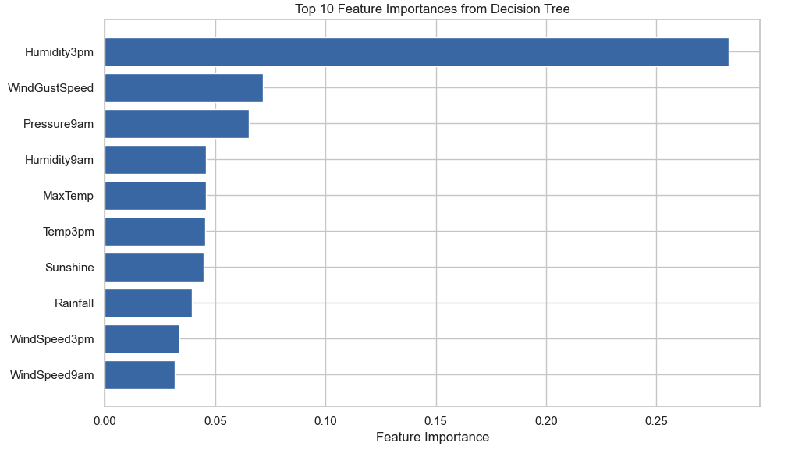
Feature analysis
Afternoon Humidity is the most predictive feature – it will signal next day rain the best (~0.28)
Wind Gust Speed and Morning Pressure are secondary but could still be valuable and can potentially signal a change in weather

Slide 7
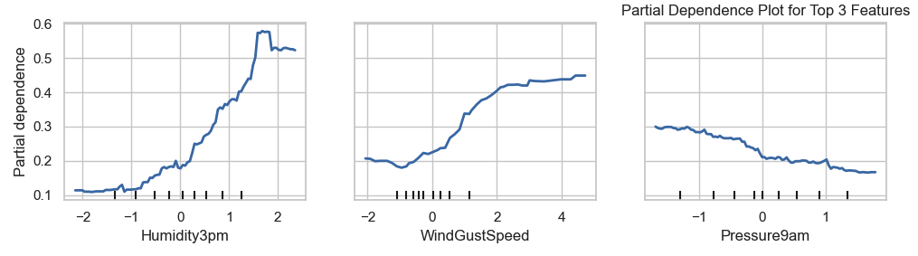
Feature analysis
Strong positive relationship
Low afternoon humidity, predicted rain probability is low
As afternoon humidity increases, sharp rise of predicted rain probability (~58%)
Positive relationship with generally increasing trend
Stronger wind gusts tend to increase the chance of rain tomorrow, but the effect plateaus at higher wind speeds (~45%)
Negative Relationship
Higher pressures correspond to lower predicted rain probability.
Lower morning pressure increases the model’s predicted likelihood of rain (~30%)

Slide 8
Modelling & Scoring
Model | Logistic Regression | Random Forest | XG Boost
Rationale | Simple and Efficient Strong baseline model for comparison Explainability (coefficient show effect of feature on odds of rain) | Robust to outliers and overfitting for shallow trees Built in feature importance Data with non-linear patterns | Great for tabular datasets (weather data) Handles imbalance of dataset well
Scoring (Test Data) | Accuracy: 79.9% Precision: 53.1% Recall: 78.4% F1 Score: 0.633 ROC AUC: 0.875 | Accuracy: 85.9% Precision: 78.3% Recall: 50.5% F1 Score: 0.61 ROC AUC: 0.89 | Accuracy: 82.5% Precision: 57.7% Recall: 79% F1 Score: 0.67 ROC AUC: 0.90

Slide 9
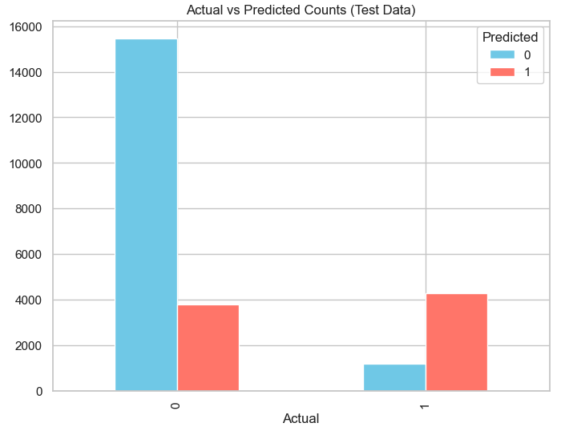
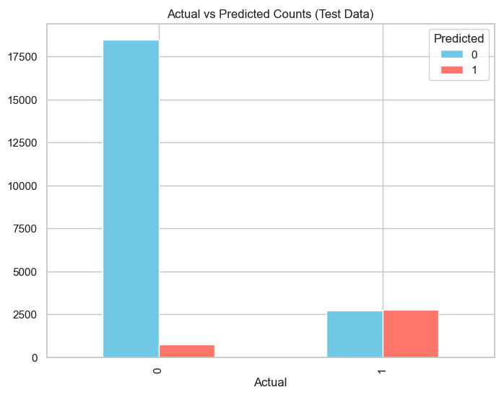
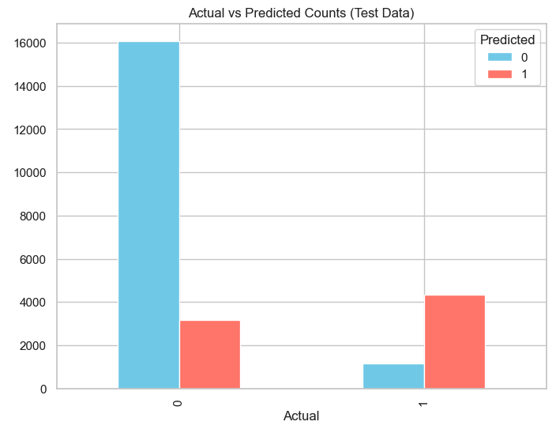
prediction
Logistic Regression
Random Forest
XG Boost
Catching Rain Events? | Logistic Regression (Fast) or XG Boost – high recall
Avoiding False Rain Alerts? | Random Forest – high precision
Overall Balanced Performance | XG Boost

Slide 10
summary and Future work
Insights Summary
Afternoon Humidity will signal next day rain the best in Australia and has a strong positive relationship with rain
Logistic Regression, Random Forest and XG Boost can all predict next day rain with acceptable scores however it is essential to note that dependent on the need some models are more fit for purpose
Overall XG Boost is the best model predictor
Future Work
Acquire more recent weather data for Australia
Further Analysis potentially split by locations or states in Australia to see if the behaviour changes
More iterations to further fine tune hyperparameters (esp. for Random Forest and XG Boost) to improve scores
Model deployment

Slide 11
Thank you!

